Slide 1
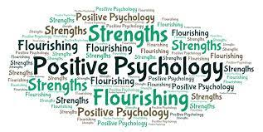
Chapter 2
Myths and Misunderstandings about the Science of Positive Psychology
The Science and Application of Positive Psychology
© Cambridge University Press 2021

Slide 2
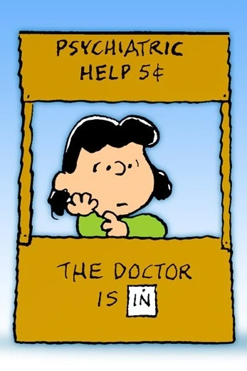

How to Distinguish
Positive Psychology from Non-Scientific
Pop Psychology

Slide 3
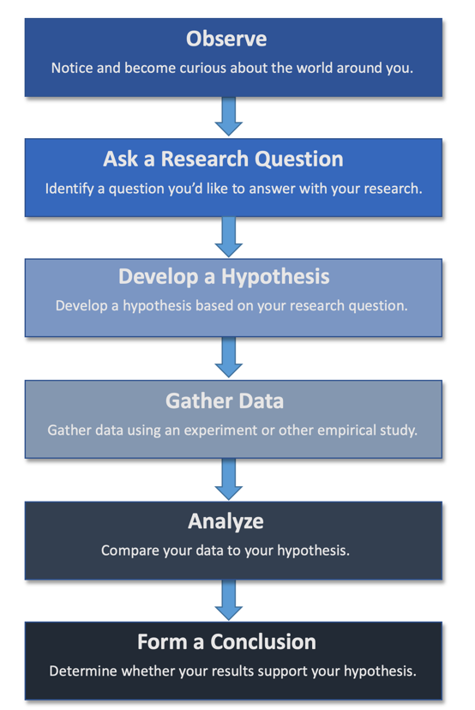
    Are the conclusions based on the scientific method?

Slide 4
    Does the research make it clear that causation isn’t the same as correlation?
Correlation: How strongly a pair of variables relate to one another and thus change together.
Correlation does not equal causation.
Correlations between two variables can also be caused by a third variable that affects both of them, known as a confounder.
Notes:
Grateful people more likely to make positive interpretations of situations and more likely to remember events more positively.

Slide 5

    Does the research make it clear that causation isn’t the same as correlation?
To make causal statements, we need a kind of study known as a true experiment, in which researchers manipulate one variable to see if it causes a change in the other.
Notes:
Grateful people more likely to make positive interpretations of situations and more likely to remember events more positively.

Slide 6
    Do the researchers generalize appropriately?
Generalization: The act of taking the results from a sample and applying it to a larger population.
To determined how generalizable a piece of research is, it’s useful to know two things:
  Is the sample size sufficient?
  How representative of the population is the sample?
Notes:
Grateful people more likely to make positive interpretations of situations and more likely to remember events more positively.

Slide 7
    Do the researchers use valid and reliable measures?
Reliability: The consistency of a measure’s results.
Types of reliability:
  Test-retest reliability: The ability of a test to give the same (or at least similar) score every time it is administered to the same person.
  Inter-rater reliability: The ability of two observers (aka, raters) of someone’s behavior to come away with the same conclusions.
  Internal consistency reliability
Notes:
Grateful people more likely to make positive interpretations of situations and more likely to remember events more positively.

Slide 8
    Do the researchers use valid and reliable measures?
Validity: The extent to which a method of measurement actually measures what it claims to measure.
  Example: A self-report scale of optimism known as the Life Orientation Test (LOT), initially faced criticism because it appeared to measure not only optimism, but also general emotional stability (Smith, Pope, Rhodewalt, & Poulton, 1989). So, the creators of the LOT revised some of the items. The resulting Revised Life Orientation Test (LOT-R), is now a “gold standard” for the valid measurement of optimism.
Notes:
Grateful people more likely to make positive interpretations of situations and more likely to remember events more positively.

Slide 9

Life Orientation Test-R
Journal Entry #4
Life Orientation Test-R

Slide 10
    Does more than one study show the result?
Replicability: The capability of two or more studies, often with somewhat different methodologies, to produce the same result.
In the early 2010s, the “replication crisis” rocked the field of psychology:
  A group of 270 researchers calling themselves the Open Science Collaboration (2015) attempted to replicate 100 studies appearing in three high-ranking journals.
  Only about a third of these attempted replications found statistically significant results.
Notes:
Grateful people more likely to make positive interpretations of situations and more likely to remember events more positively.

Slide 11
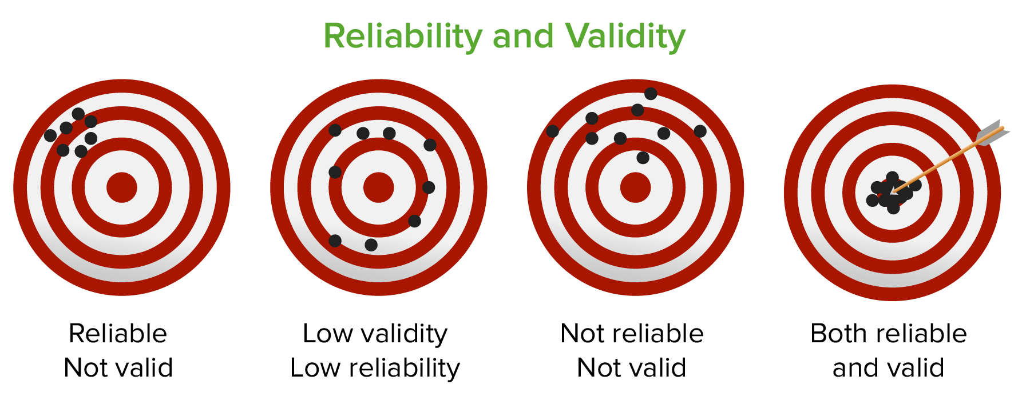
Reliability and Validity

Slide 12
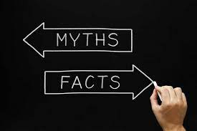
Myths and Misunderstandings about Positive Psychology

Slide 13
Myth #1: Only stupid people are happy
Related to the old saying, “Ignorance is bliss.”
A number of studies have investigated the correlations between scores on IQ tests and happiness, typically finding no relationship (e.g., Watten, Myhrer, & Swersen, 1995; Gow et al., 2005; Hartog, 1998).

Slide 14
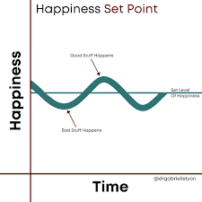
Myth #2: You can’t do anything about your level of happiness
Happiness Set Point: A point to which people’s happiness returns after major life events. Not completely a myth.
The set point is probably partially genetic. Studies of genetically identical twins and adopted siblings support the notion that happiness is at least partly heritable (see Bartels, 2015).

Slide 15
Myth #2: You can’t do anything about your level of happiness
Implications of the happiness set point:
  Positive implication: People aren’t generally as affected in the long term by negative events as one might expect.
  Negative implication: Although we can strive to obtain accomplishments, objects, and experiences, this is a never-ending quest, given that the positive emotions from these outcomes rarely stick around long. Psychologists refer to this as being on a hedonic treadmill (Brickman & Campbell, 1971).

Slide 16
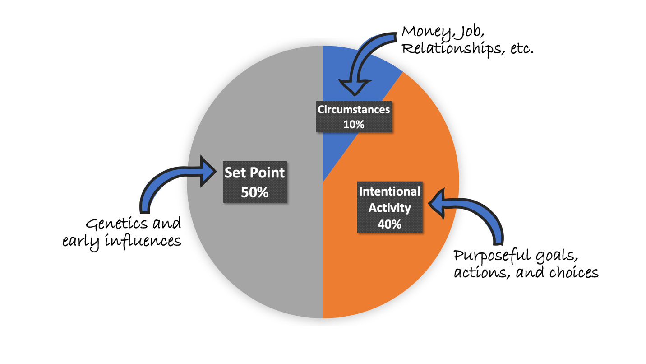
Myth #2: You can’t do anything about your level of happiness
The Happiness Pie

Slide 17
Well-Being Journal Entry #5:
Consider Your Piece of the Pie
40% of what accounts for happiness is potentially controllable by changing our attitudes and behaviors. There are, of course, many factors in peoples’ lives they can’t control. Take a few minutes to write down a few things you can’t control and a few things you can control, that might have an influence on your happiness.
Notes:
Consider asking students to pair off and discuss their lists with one another, noting similarities and differences. This can be followed by an all-class discussion.

Slide 18
Consider Your Piece of the Pie Challenge
Choose one or more of these practices that you can control to impact your happiness and try it for a week. Consider whether it’s something you could benefit from practicing a few times throughout the week or whether it could have an impact if done only once. Then add to your journal about what happened to your level of happiness as a result.
Extended challenge: Continue throughout the semester and reflect again at the end of the semester and add that to your journal too

Slide 19
Myth #3: Positive psychology is only about being happy
Not everything that is “positive” in pleasurable.
Hedonic vs. eudaimonic well-being.
Even negative emotions can potentially be helpful.
  Important study (Forgas & East, 2008): Experimenters asked participants to play the role of a seller, negotiating with a buyer. Their task was to sell a batch of mobile phones to the buyer (who was actually an actor) at the highest price. Part-way through the experiment, some participants were led to believe that the buyer was angry with them, whereas others were led to believe that the buyer felt happy. The results showed that participants who believed they were dealing with an angry buyer offered their cell phones at more than a 30 percent discount over participants who thought they were dealing with a happy buyer, indicating that anger acted as a benefit, at least for the buyer.

Slide 20
Myth #4: Positive psychology is only for the privileged
Consistent with this idea, research shows that people who lack basic resources and freedoms are often less happy than those who are afforded these advantages. For instance, people are generally happier in nations that provide higher levels of freedom (Rahman & Veenhoven, 2018).
Nonetheless, this idea probably isn’t completely true.
  In all parts of the world, people strive for and have positive emotions and experiences, and under a surprisingly wide variety of circumstances, including some very difficult ones.
  Example: As the world experienced the COVID-19 pandemic, huge numbers of people faced financial insecurity, fear of infection, and the loss of loved ones. Although it will be a while until we have enough solid research to truly understand the psychological impacts of this period, people nonetheless continued to build community (O’Sullivan, 2020), experience gratitude (Law, 2020), set new goals (Brough, 2020), and even laugh (McTague, 2020).

Slide 21
Culture and the Science of Positive Psychology
Research shows that the levels of happiness reported by individuals of marginalized racial and ethnic groups are lower, on average, than for White individuals.
Known as the happiness gap.
It’s one of many racial disparities that exist in the United States, including disparities in income and wealth, life expectancy, and education.

Slide 22
Which of these myths did you come into the course believing and why?
Myth #1: Only stupid people are happy
Myth #2: You can’t do anything about your level of happiness
Myth #3: Positive psychology is only about being happy
Myth #4: Positive psychology is only for the privileged

Slide 23
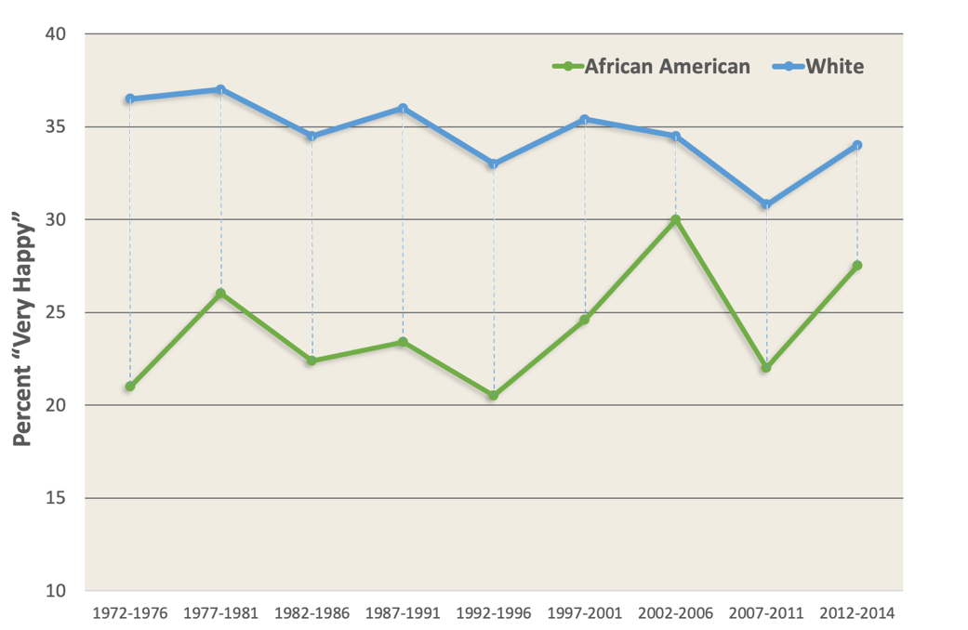
Culture and the Science of Positive Psychology
Iceland and Ludwig-Dehm (2019) tracked the happiness gap for Black Americans and White Americans from 1972 to 2014 using data from the General Social Survey (GSS).

Slide 24
Culture and the Science of Positive Psychology
Most studies of the happiness gap have focused on disparities in happiness among Black and White Americans. Thus, more research is needed to investigate similar happiness gaps in other diverse groups.
It is important for future studies to incorporate the concept of intersectionality—meaning that people have complex, multiple, overlapping identities, including (among many others) their race, gender identity, age, sexual orientation, nationality, socioeconomic status, and religion.
Because each of these identities is the subject of differing levels and types of oppression and privilege, understanding how they intersect allows for greater knowledge of how and why happiness gaps exist and persist.

